Slide 1


Who The Hell Is Data Scientist ?
By Rinki Nag

Slide 2
Flow of this session
1) What is data and why should I bother about it?
2) How can these numbers help in problem-solving?
3) How do these data scientists help me in making any organization data-driven?
4) Can they do it all alone? Who are those data warriors?
5) What is a full-stack data scientist?
6) How can I get started?
7) Q & A

Slide 3



What is data and why should I bother about it?
Notes:
Where do we get this data ?
How are this data collected ?
What is difference between a data warehouse and data lake??
What are the potential sectors ?

Slide 4






Sectors for having tons of data are potential data factory
Notes:
Ask them for some more examples

Slide 5
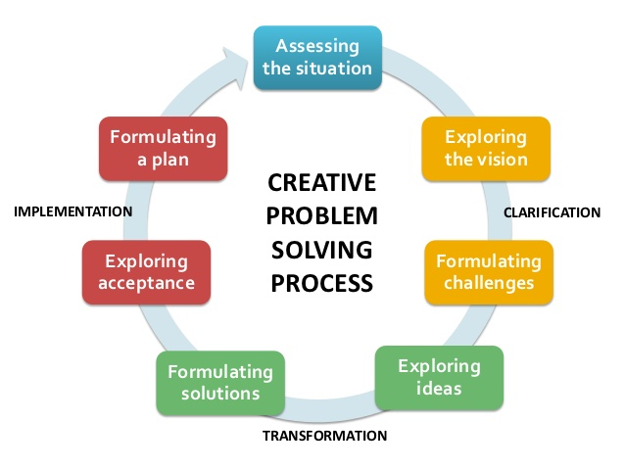
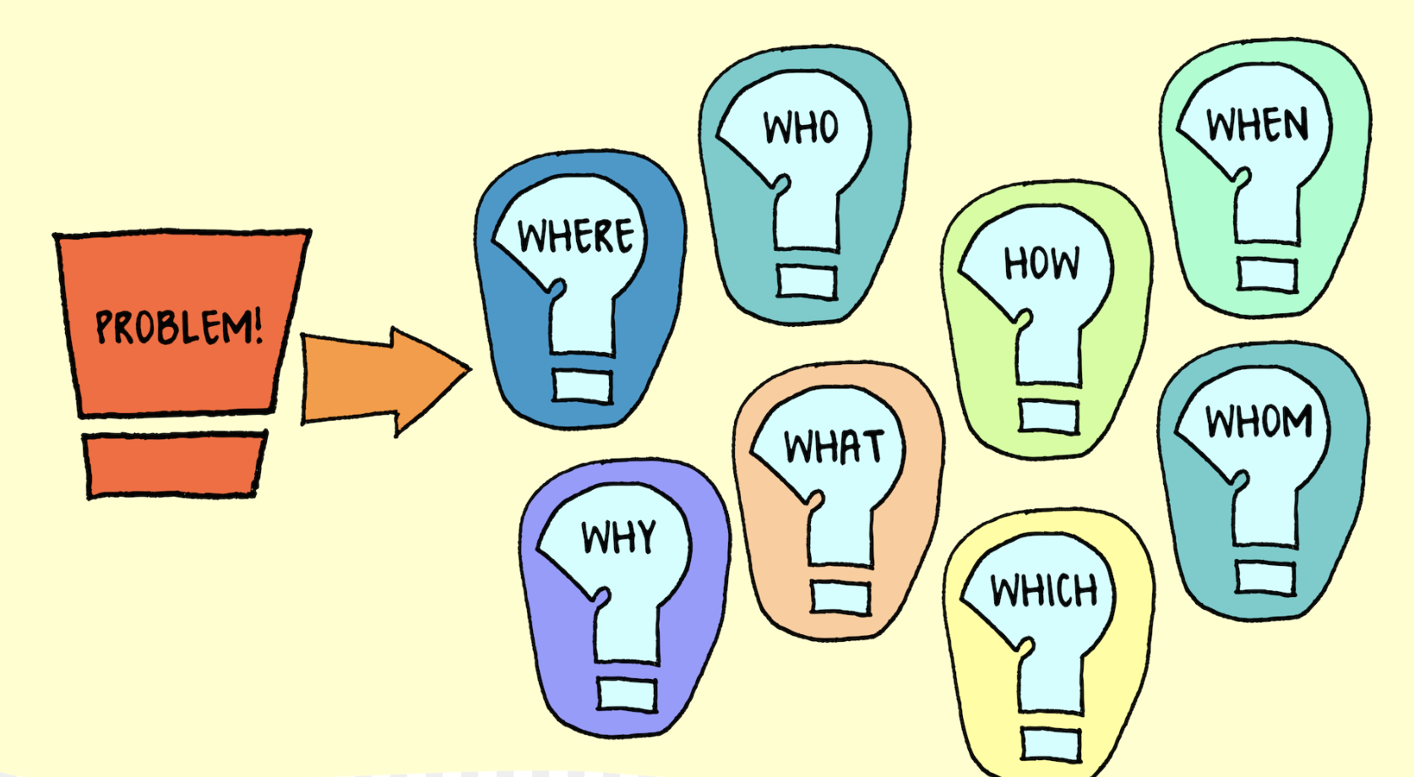
How can these numbers help in problem-solving?
Notes:
What are some use cases of data science??

Slide 6





Companies using data science for generating profit or say Data Driven Organisations

Slide 7
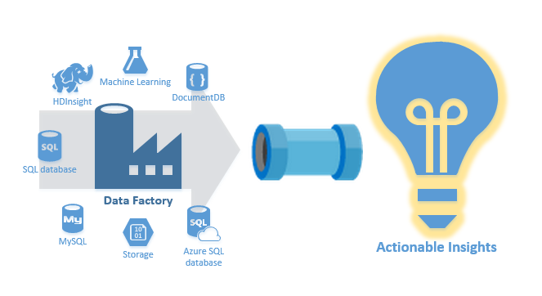



How do these data scientists help me in making my organization data-driven?
1. Defining the problem statement
3. Applying and evaluating ML algorithms and see its adaptability
2. Gathering data forming Data-lake and the performing ETL or ELT to make Data-warehouse , getting insights to further move on to ML phase
4. Deploying the machine learning model for use at scale

Slide 8




Can they do it all alone? Who are those data warriors?
Business People + Data Analyst
Business People +Data Engineer +Data Analyst +Data Scientist
Data Scientist
Data Engineer

Slide 9
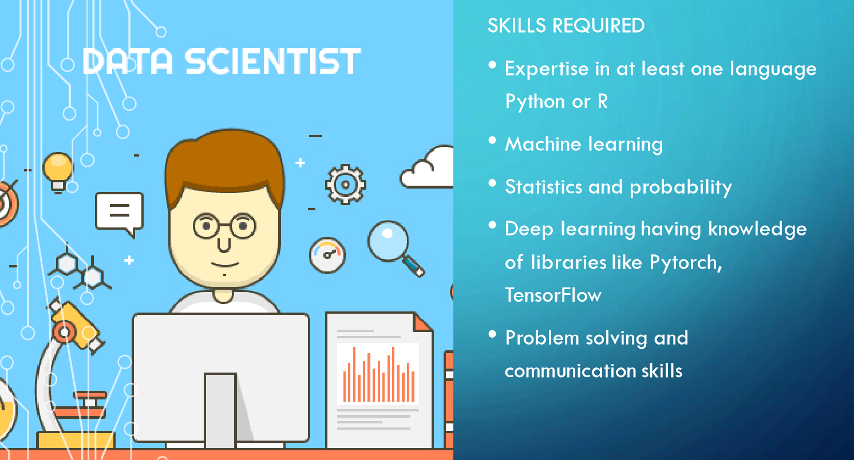
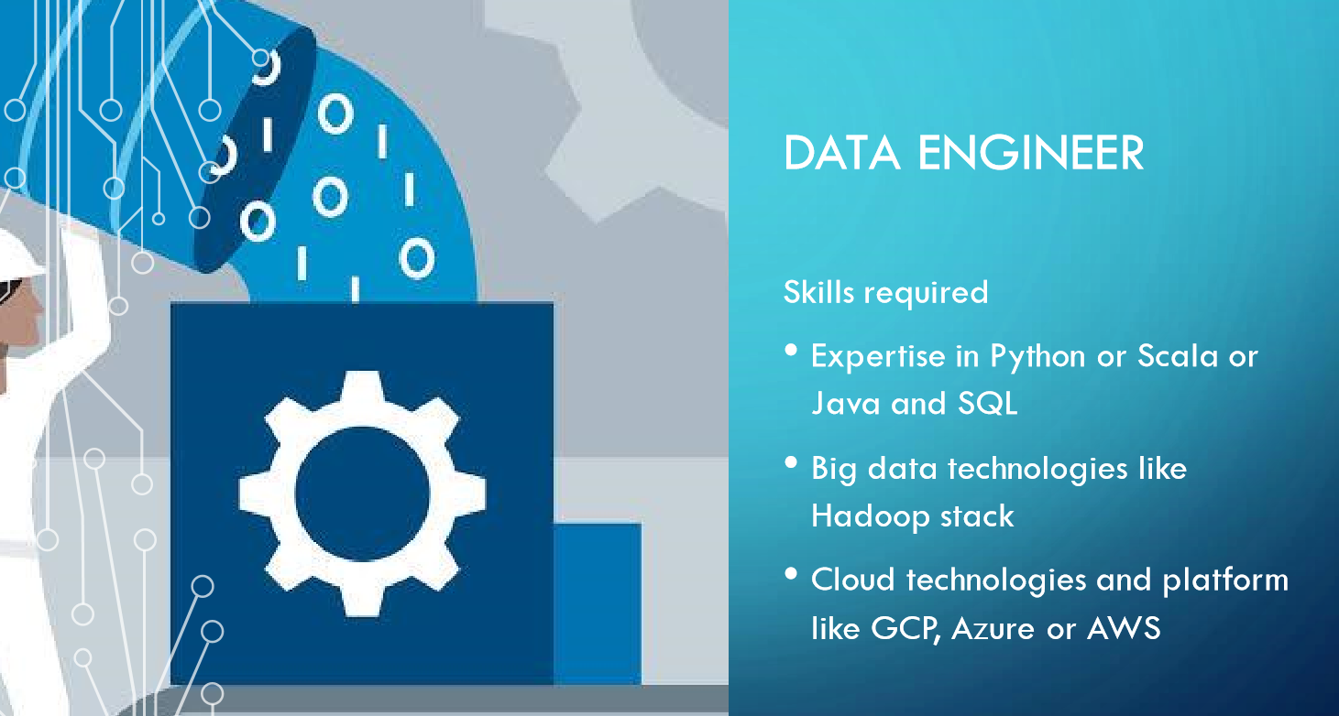
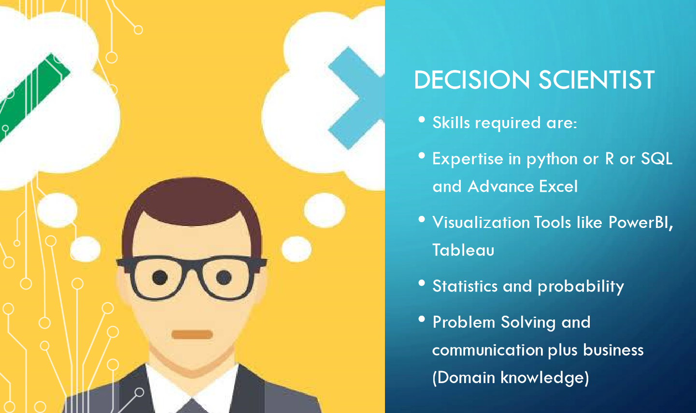
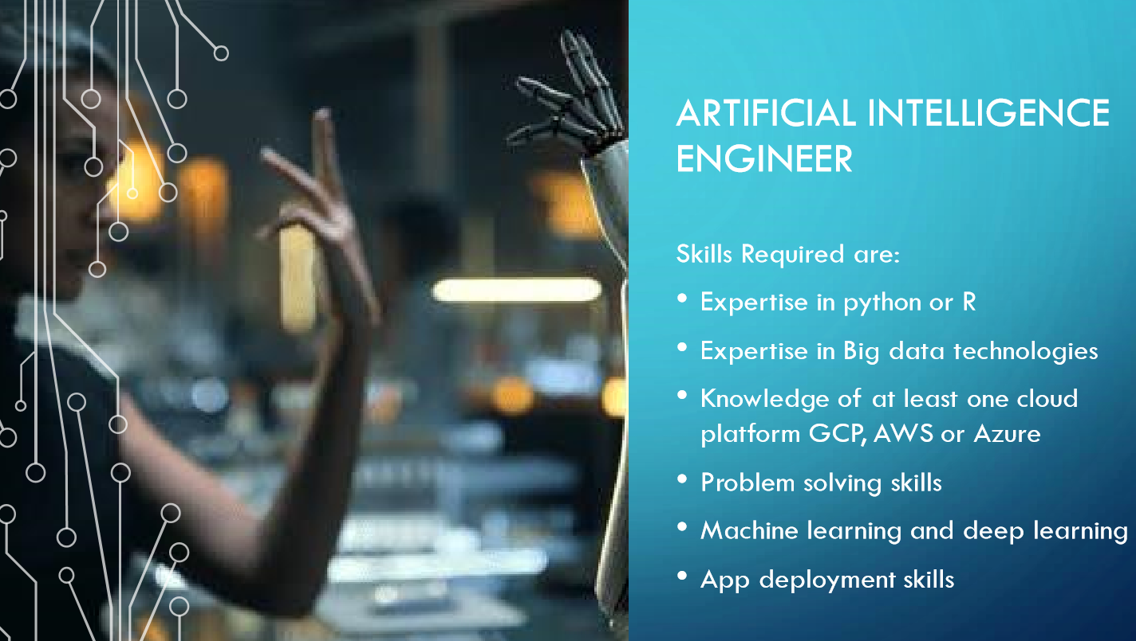

Slide 10

What is a full-stack data scientist or AI engineer ? Why they are so much in demand?

Slide 11
How can I get started?
Start with any programming language , python is one of my favorite and easiest programming language
Try to automate stuffs start with solving your own problem or your friends boring stuffs read how to automate boring stuffs with python (awesome read)
Solve problems on Hacker rank , Leetcode, codesignal .Start with solving 3 problems a week make it a habit
Make your LinkedIn Profile PRO and GitHub is future resume , write blog articles its important

Slide 12
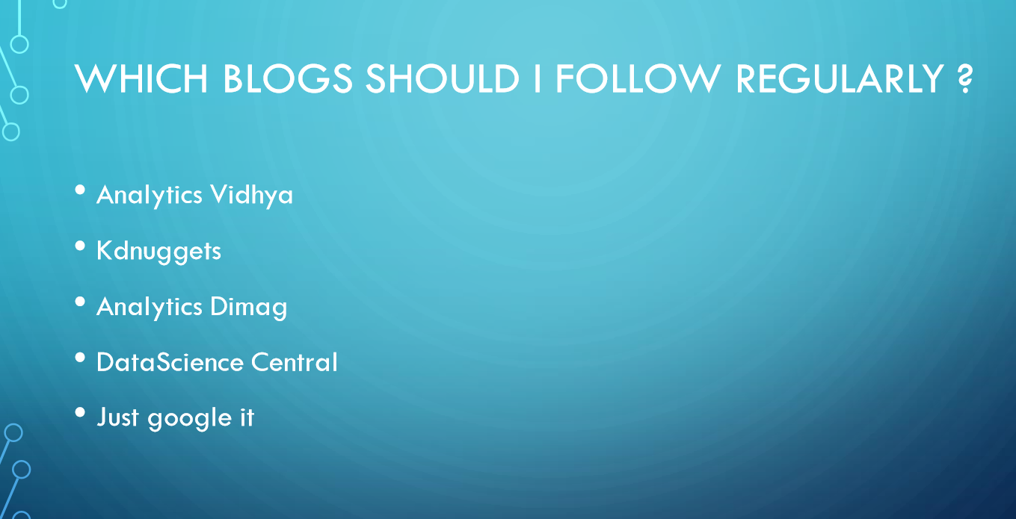

Slide 13


Slide 14
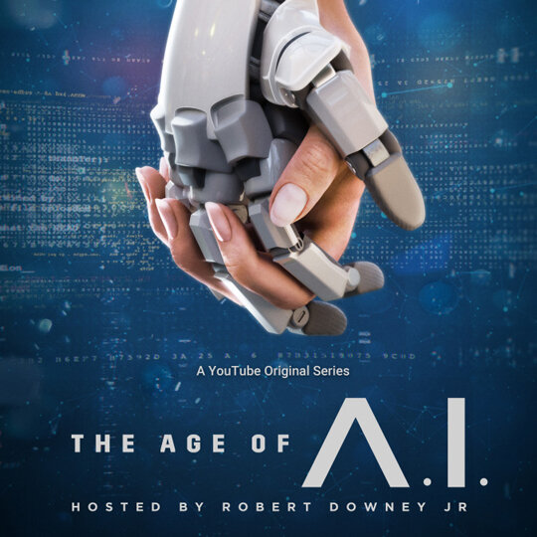


Starting Anything most Important thing required is Motivation
I personally get motivated from Books and movies

Slide 15


Who the Hell is Data Scientist ? Ans: Jack of All Trades

Slide 16



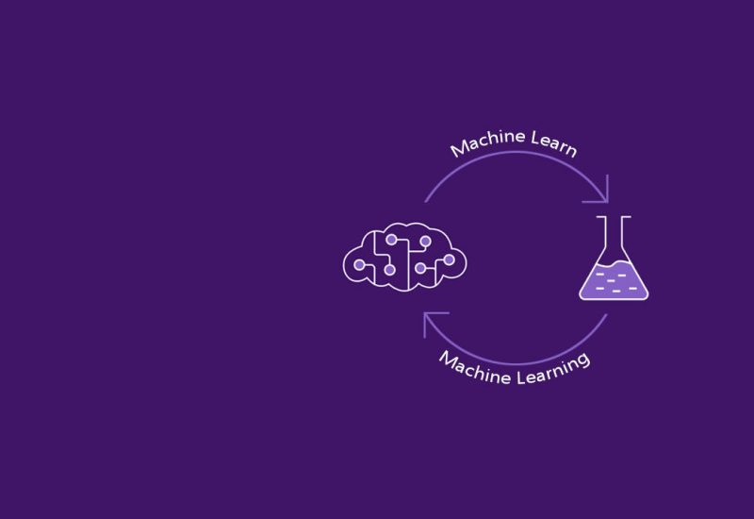
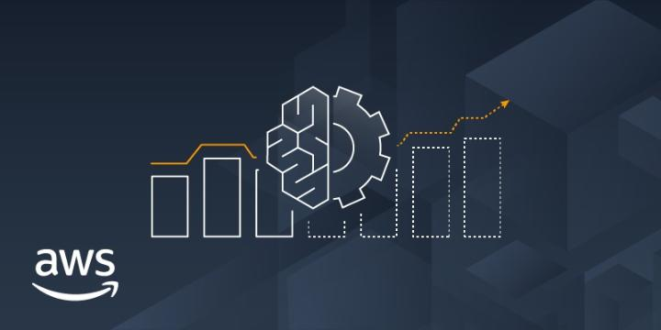

Will recession or Automation Take away Jobs of Data scientist or people involved in pipeline?

Slide 17






Advancement and evolution is truth
Nothing is permanent

Slide 18

Only thing that can save us is learning and continuously upgrading

Slide 19
Q & A

Slide 20
Thank You

